Slide 1
Wi-Fi:
Starspace 46 guest
Password:
Techlahoma

Slide 2
If you haven’t had a chance to RSVP for today’s meetup yet, please do that now!
meetup.com/freecodecampokc

Slide 3
Thanks for joining us today! We're here thanks to volunteers, speakers, and Techlahoma.

Slide 4
Techlahoma.org
non-profit volunteer-run organization
hosts 33 groups and 2 conferences
sponsors free local events
supports the grassroots tech community of Oklahoma

Slide 5
200OK.us
Annual conference in Tulsa on May 18th
Call for sponsors is open. If your company wants to advertise at 200OK and support Techlahoma, go to 200ok.us and click Sponsors to get more information.

Slide 6
StarSpace46.com
Event Center is donated by StarSpace46.
If you like them and want them to stick around, get a $40 community membership.
www.starspace46.com/calendar-1

Slide 7
donate.techlahoma.org/membership
If you like this meetup and what we do here, please consider becoming a Techlahoma member.
Funding allows Techlahoma to help user groups like this around the state and host 2 great conferences.
Thank you!

Slide 8
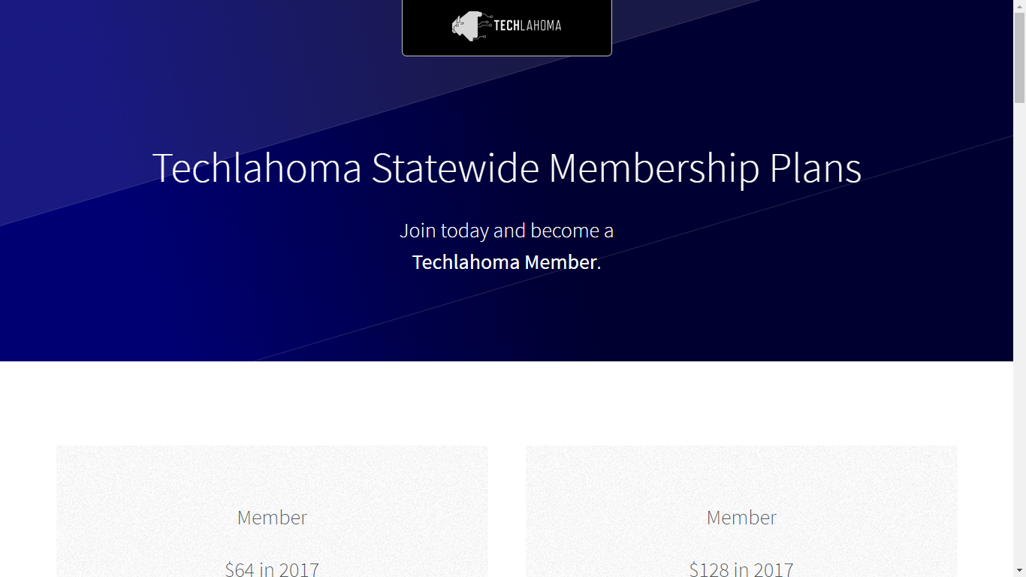
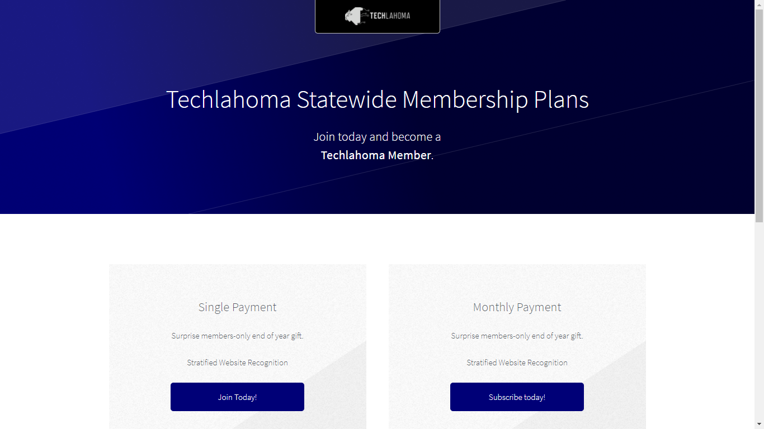

Slide 9
Twitch.tv/Techlahoma
Live streaming at StarSpace46
Subscribe with Amazon Prime
Techlahoma gets a small donation from Amazon

Slide 10
OKC Coffee & Code
Next meetup will be scheduled soon!
Contact Kimberly Collins for details
meetup.com/okccoffeeandcode

Slide 11
OKC Python
Wednesday 2/14
11:30 - 12:30
Machine Learning with Scikit-Learn
www.meetup.com/okcpython

Slide 12
CocoaHeads OKC
Thursday 2/15
11:30 - 12:30
SiriKit with Tyler Jones
www.meetup.com/cocoaheads-okc

Slide 13
DevOps OKC
Friday 2/16
11:30 - 12:30
SaltStack with Floyd May
www.meetup.com/devopsokc

Slide 14
Free Code Camp OKC
Sunday 2/18
2:00 - 3:00 pm
Angular with Jeff Maxwell
meetup.com/freecodecampokc

Slide 15
OKC SQL
Monday 2/19
6:00 - 8:00 pm
Becoming a Public Speaker
meetup.com/okcsql

Slide 16
Free Code Camp OKC
Sunday 2/25
1:00 - 2:00 pm
Lightning Talks (Sign up to speak!)
meetup.com/freecodecampokc

Slide 17
FreeCodeCampOKC.com
facebook.com/groups/free.code.camp.oklahoma.city
linkedin.com/groups/12086660
meetup.com/FreeCodeCampOKC
twitter.com/FreeCodeCampOKC

Slide 18
Slack
fccokc.com/slack
Channels for #freecodecamp, #jobs, #javascript, #design, and over 150 other topics
Questions? @kimberlycollins

